Slide 1
Descriptive Statistics Part -1
Sourav Karmakar
souravkarmakar29@gmail.com

Slide 2
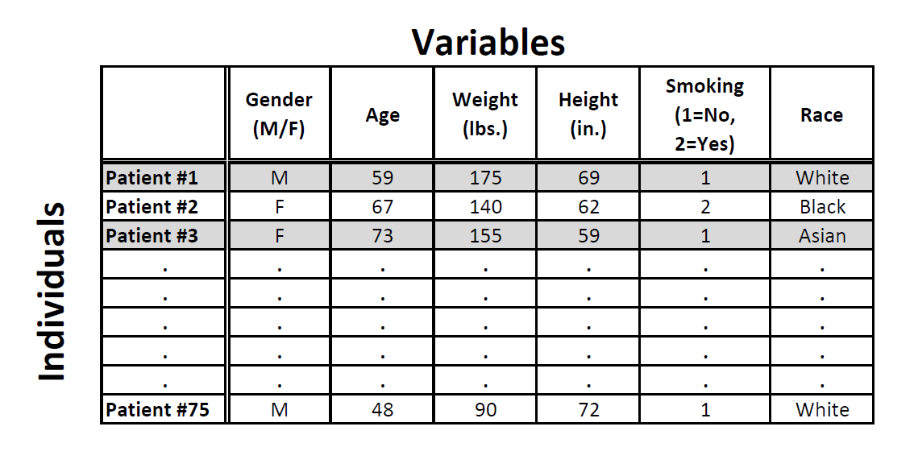
Data and Variables
Data are pieces of information about individuals organized into variables.
By an individual (also called record), we mean a particular person or object.
By a variable, we mean a particular characteristic of the individual.
The following dataset shows medical records from a particular survey:
Usually variables are arranged across columns while the individuals (records) are arranged across rows

Slide 3
Data and Variables
Variables can be classified into one of two types: categorical or quantitative.
Categorical variables take category or label values and place an individual into one of several groups. Each observation can be placed in only one category, and the categories are mutually exclusive.
Quantitative variables take numerical values and represent measurement.
In our example:
Gender and Smoking are categorical variables.
Age, Weight and Height are quantitative variables.

Slide 4
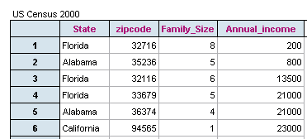


Data and Variables
We took a random sample from the 2000 U.S. Census. Here is part of the dataset:
Census is an official count or survey, especially of a population.
Q.1. Who are the individuals described by this data?
States
People living in the United States in the year 2000
People with families in the year 2000
The U.S. Census is completed by people living in the United States.
Q.2. What type of variable is Zipcode?
Categorical
Quantitative
Q.3. What type of variable is Annual Income?
Categorical
Quantitative
Zipcode is a categorical variable because it categorizes individuals by geographic location
Annual Income is a Quantitative variable because it assumes continuous values over a range and has arithmetic significance.

Slide 5











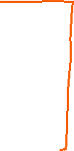



Slide 6



Slide 7
Distribution of Variables
We will begin our journey of Descriptive Statistics by exploring (or looking at) one variable at a time.
As we saw in the previous slides, usually a variable in a data consist of long list of values (whether numerical or not) and are not very informative in that form.
In order to convert these raw data into useful information we need to summarize and then examine the distribution of the variable. By distribution of a variable, we mean:
what values the variable takes, and
how often the variable takes those values.
We will first learn how to summarize and examine the distribution of a single categorical variable, and then do the same for a quantitative variable.

Slide 8
Distribution of Variables
Examining Distribution of Categorical Variable
Suppose we have taken a survey among the office-goers on the mode of daily commutes.
Few office-going people were randomly chosen and they were asked how they travel from home to office on a regular basis. The dataset we obtain looks something like below.
Persons | Types of Daily Commute
1 | Public Transport
2 | Public Transport
3 | Two - Wheeler
. . . | . . .
1198 | Four - Wheeler
1199 | Public Transport
1200 | Two - Wheeler
Following are the findings from the given dataset
There are three mode of transports that people avail.
Public Transport
Own Two-Wheeler vehicle
Own Four-Wheeler vehicle
There are total 1200 rows or individuals in the dataset

Slide 9
Distribution of Categorical Variable
Suppose we ask: What percentage of sampled office-goers fall into each category?
This question will be easily answered once we summarize and look at the distribution of the variable “Types of Daily Commute”.
In order to summarize the distribution of a categorical variable, we first create a table of the different values (categories) the variable takes, how many times each value occurs (count) and, more importantly, how often each value occurs (by converting the counts to percentages); this table is called a frequency distribution. Here is the frequency distribution for our example:
Categories | Count | Percentage
Public Transport | 527 | 43.92%
Two-Wheeler | 425 | 35.42%
Four-Wheeler | 248 | 20.67%
Total | 1200 | 100.00%

Slide 10
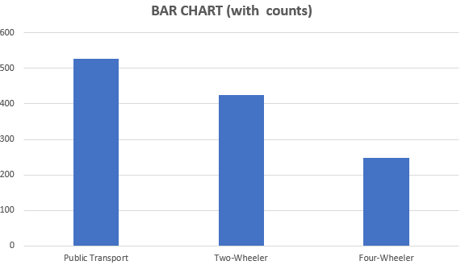
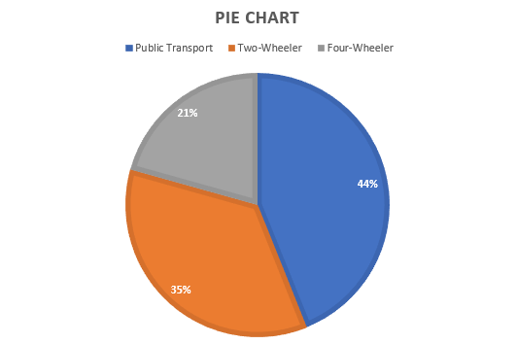
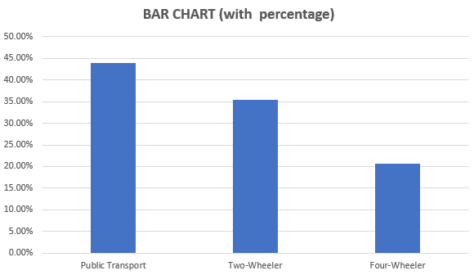
Distribution of Categorical Variable
We can express the result pictorially with the help of Bar charts or Pie Charts
Categories | Count | Percentage
Public Transport | 527 | 43.92%
Two-Wheeler | 425 | 35.42%
Four-Wheeler | 248 | 20.67%
Total | 1200 | 100.00%

Slide 11
Distribution of Variables
Examining Distributions of Quantitative Variable
Histogram: Intervals
Break the range of values into intervals and count how many observations fall into each interval.
Score Intervals | Counts
[40-50) | 1
[50-60) | 2
[60-70) | 4
[70-80) | 5
[80-90) | 2
[90-100] | 1
Examples: Here are the exam grades of 15 students-
88, 48, 60, 51, 57, 85, 69, 75, 97, 72, 71, 79, 65, 63, 73
We first need to break the range of values into intervals (also called "bins" or "classes"). By counting how many of the 15 observations fall in each of the intervals, we get the table as shown:

Slide 12
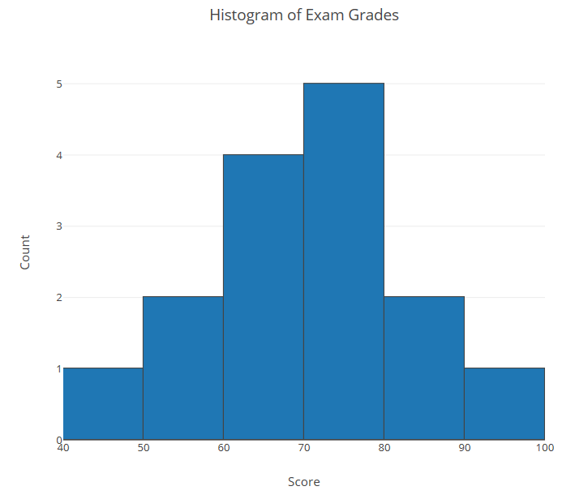
Distribution of Quantitative Variable
Score Intervals | Counts
[40-50) | 1
[50-60) | 2
[60-70) | 4
[70-80) | 5
[80-90) | 2
[90-100] | 1
To construct the histogram from this table we plot the intervals on the X-axis and show the number of observations in each interval (frequency of the interval) on the Y-axis, which is represented by the height of a rectangle located above the interval.

Slide 13

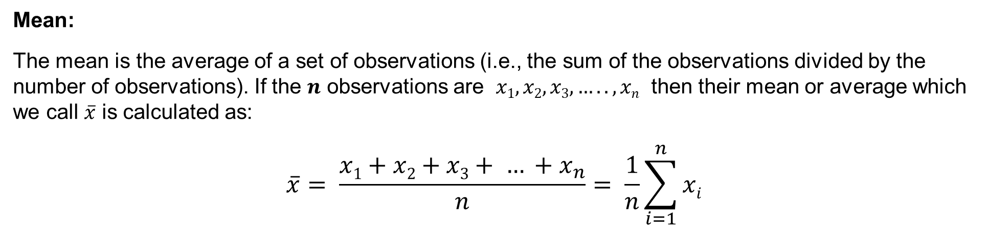


Distribution of Quantitative Variable
Measure of Central Tendency:
The three main numerical measures for the center of a distribution are the mode, the mean and the median.
Mode:
The mode is the most commonly occurring value in a distribution.
Mean:
The mean is the average of a set of observations (i.e., the sum of the observations divided by the number of observations). If the $n$ observations are $x1, x2, x3, ….. , xn$ then their mean or average which we call $\overline{x}$ is calculated as:
$$\overline{x}= \frac{x1+x2+x3+ … +x_{n}}{n}= \frac{1}{n}\sum_{i=1}^{n}{xi}$$

Slide 14
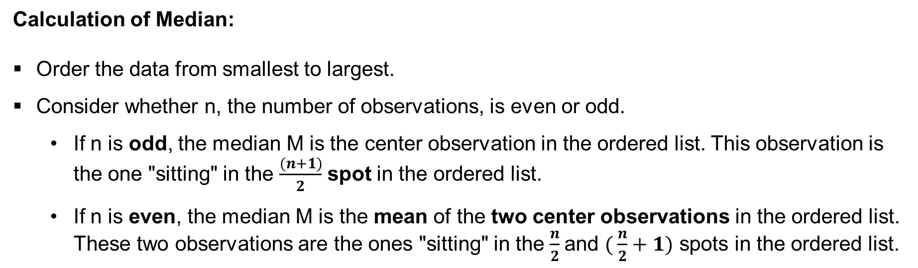
Distribution of Quantitative Variable
Median:
The median is the midpoint of the distribution. It is the number such that half of the observations fall above, and half fall below.
Calculation of Median:
Order the data from smallest to largest.
Consider whether n, the number of observations, is even or odd.
If n is odd, the median M is the center observation in the ordered list. This observation is the one "sitting" in the $\frac{(n+1)}{2}$ spot in the ordered list.
If n is even, the median M is the mean of the two center observations in the ordered list. These two observations are the ones "sitting" in the $\frac{n}{2}$and $( \frac{n}{2}+1)$ spots in the ordered list.

Slide 15
Distribution of Quantitative Variable
Calculation of Median (Example):
Consider the following numbers:
12, 18, 11, 4, 14, 18, 11, 5, 12, 7, 3, 12, 23, 9, 16, 1, 5, 17, 3, 13, 21
The ordered numbers from small to large is:
1, 3, 3, 4, 5, 5, 7, 9, 11, 11, 12, 12, 12, 13, 14, 16, 17, 18, 18, 21, 23
Here n = 21 (odd). Therefore, the $\frac{(n+1)}{2} th$ data i.e. 11th data here will be the median.
Hence, median = 12.

Slide 16
Distribution of Quantitative Variable
Measure of Dispersion / Spread:
These measures provide different ways to quantify the variability of the distribution. We will discuss the following three most commonly used measures of spread.
Range
Variance & Standard Deviation and
Inter-Quartile Range (IQR)
Range:
Range is exactly the distance between the smallest data point (min) and the largest one (Max). i.e., Range = Max – Min
Example-1: 12, 18, 11, 4, 14, 18, 11, 5, 12, 7, 3, 12, 23, 9, 16, 1, 5, 17, 3,
Here Max = 23 and Min = 1.
Hence, Range = Max – Min = 23 -1 = 22

Slide 17
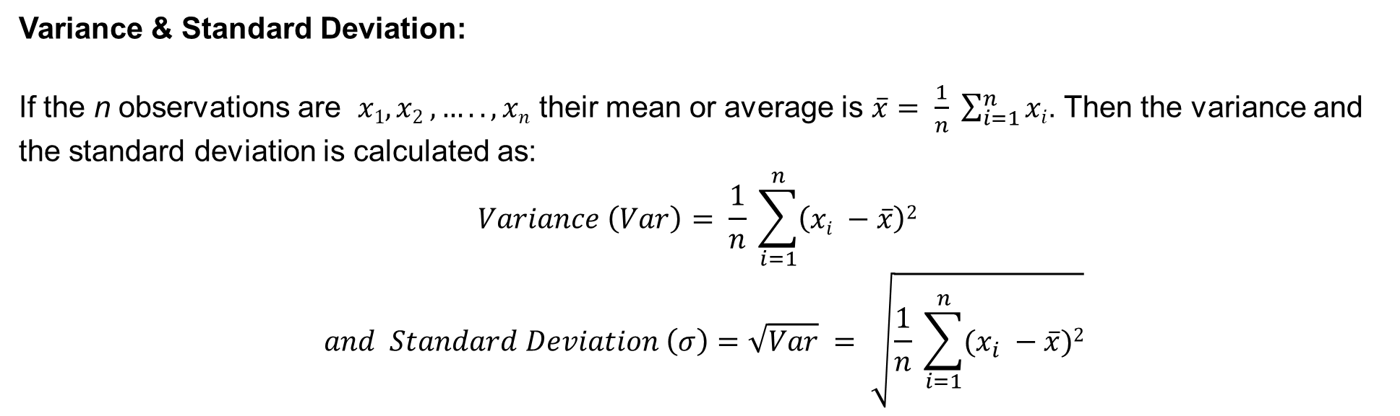
Distribution of Quantitative Variable
Variance & Standard Deviation:
If the n observations are $x1, x2 , ….. , xn$ their mean or average is $\overline{x}= \frac{1}{n} \sum_{i=1}^{n}{xi}$. Then the variance and the standard deviation is calculated as:
$$Variance \left(Var\right)= \frac{1}{n} \sum_{i=1}^{n}{\left(xi −\overline{x}\right)2 }$$
$$and Standard Deviation \left(σ\right)=\sqrt{Var} = \sqrt{\frac{1}{n} \sum_{i=1}^{n}{(x_{i} −\overline{x}})2}$$

Slide 18
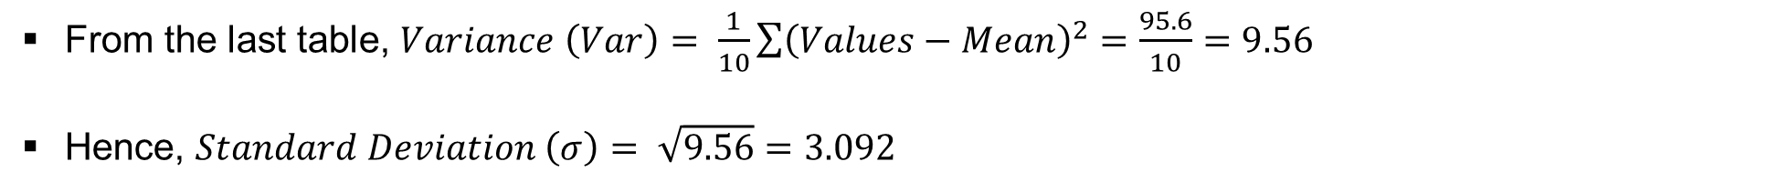
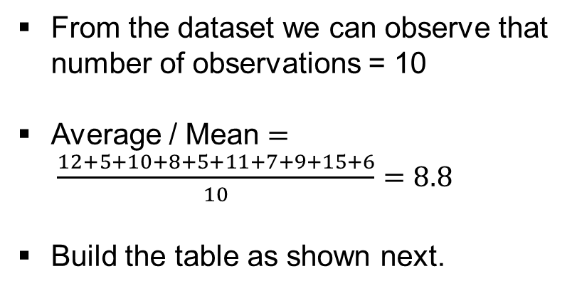
Distribution of Quantitative Variable
Example of calculation of Variance and Standard Deviation:
Consider the following example Dataset:
Sl. No. | Values
1 | 12
2 | 5
3 | 10
4 | 8
5 | 5
6 | 11
7 | 7
8 | 9
9 | 15
10 | 6
From the dataset we can observe that number of observations = 10
Average / Mean $= \frac{12+5+10+8+5+11+7+9+15+6}{10}=8.8$
Build the table as shown next.
Sl. No. | Values | Values - Mean | (Values - Mean)²
1 | 12 | 3.2 | 10.24
2 | 5 | -3.8 | 14.44
3 | 10 | 1.2 | 1.44
4 | 8 | -0.8 | 0.64
5 | 5 | -3.8 | 14.44
6 | 11 | 2.2 | 4.84
7 | 7 | -1.8 | 3.24
8 | 9 | 0.2 | 0.04
9 | 15 | 6.2 | 38.44
10 | 6 | -2.8 | 7.84
From the last table, $Variance \left(Var\right)= \frac{1}{10}\sum{{\left(Values−Mean\right)}^{2}}=\frac{95.6}{10}=9.56$
Hence, $Standard Deviation \left(σ\right)= \sqrt{9.56}=3.092$

Slide 19
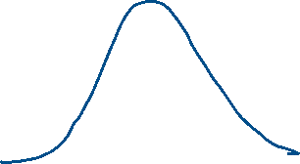





Slide 20
Distribution of Quantitative Variable
Inter Quartile Range (IQR):
The IQR measures the variability of a distribution by giving us the range covered by the MIDDLE 50% of the data. The following figure illustrates the idea.
Bottom 50% Data
Top 50% Data
Min
Max
25% Data
Q1
25% Data
M
25% Data
Q3
25% Data
Middle 50% Data
Inter-Quartile Range (IQR) = Q3 – Q1
Range
M: Median of the data
Q1: First Quartile of the data (one quarter of the data points fall below it)
Q3: Third Quartile of the data (three quarters of the data points fall below it)

Slide 21


Distribution of Quantitative Variable
Example of Calculating Inter Quartile Range (IQR):
Consider the observations: 12, 18, 11, 4, 14, 18, 11, 5, 12, 7, 3, 12, 23, 9, 16, 1, 5, 17, 3, 13, 21
Sort the observations in ascending order:
Q1 $=\frac{5+5}{2}=5$
Q3 $=\frac{16+17}{2}=16.5$
1, 3, 3, 4, 5, 5, 7, 9, 11, 11, 12, 12, 12, 13, 14, 16, 17, 18, 18, 21, 23
Min
Max
M
Find the Median (M), followed by First Quartile (Q1) and Third Quartile (Q3)
Then calculate Inter Quartile Range (IQR) = Q3 – Q1 = 16.5 – 5 = 11.5
The combination of all five numbers (min, Q1, M, Q3, Max) is called the five number summary, and provides a quick numerical description of both the center and spread of a distribution.

Slide 22
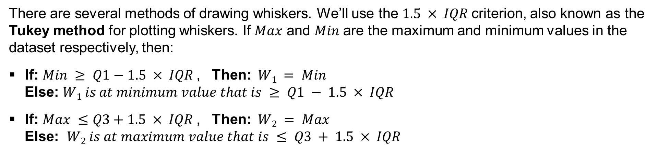
Distribution of Quantitative Variable
Box and Whisker Plot:
This is the way to visualize the distribution of quantitative variable using Five Number Summary.
Five Number Summary
M: Median
Q1: First Quartile
Q3: Third Quartile
W₁: Lower Whisker
W₂: Upper Whisker
W₁
Q1
M
Q3
W₂
There are several methods of drawing whiskers. We’ll use the $1.5 × IQR$criterion, also known as the Tukey method for plotting whiskers. If $Max$ and $Min$ are the maximum and minimum values in the dataset respectively, then:
If: $Min ≥ Q1−1.5 × IQR$, Then: $W1 = Min$
Else: $W1 is at minimum value that is ≥ Q1 − 1.5 × IQR$
If: $Max ≤Q3+1.5 × IQR$, Then: $W2 = Max$
Else: $W2 is at maximum value that is ≤ Q3 + 1.5 × IQR$

Slide 23
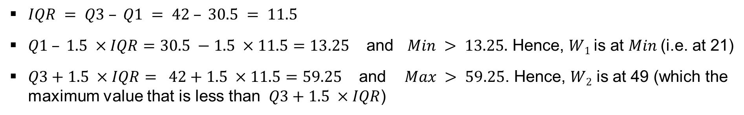
Distribution of Quantitative Variable
Example of Box and Whisker Plot:
Following are the ages of the actresses who won academy award (Oscar) from the year 1970 to 2013:
34, 34, 27, 37, 42, 41, 36, 32, 41, 33, 31, 74, 33, 49, 38, 61, 21, 41, 26, 80, 42, 29, 33, 36, 45, 49, 39, 34, 26, 25, 33, 35, 35, 28, 30, 29, 61, 32, 33, 45, 29, 62, 22, 44
On examining the data we find the following 5 number summary
Min = 21
Q1 = 30.5
M = 34.5
Q3 = 42
Max = 80
21
30.5
34.5
42
49
$IQR = Q3 – Q1 = 42 – 30.5 = 11.5$
$Q1 – 1.5 ×IQR=30.5 −1.5 ×11.5=13.25$ and $Min > 13.25.$ Hence, $W1$is at $Min$(i.e. at 21)
$Q3+1.5 ×IQR= 42+1.5 ×11.5=59.25$ and $Max > 59.25$. Hence, $W2$ is at 49 (which the maximum value that is less than $Q3+1.5 ×IQR$)

Slide 24
Thank You

